Slide 1
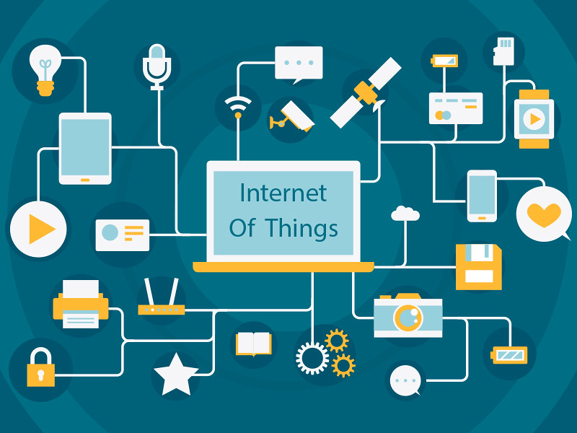
What is the internet of things
The Internet of things (IoT) describes the network of physical objects—“things”—that are embedded with sensors, software, and other technologies for the purpose of connecting and exchanging data with other devices and systems over the Internet

Slide 2
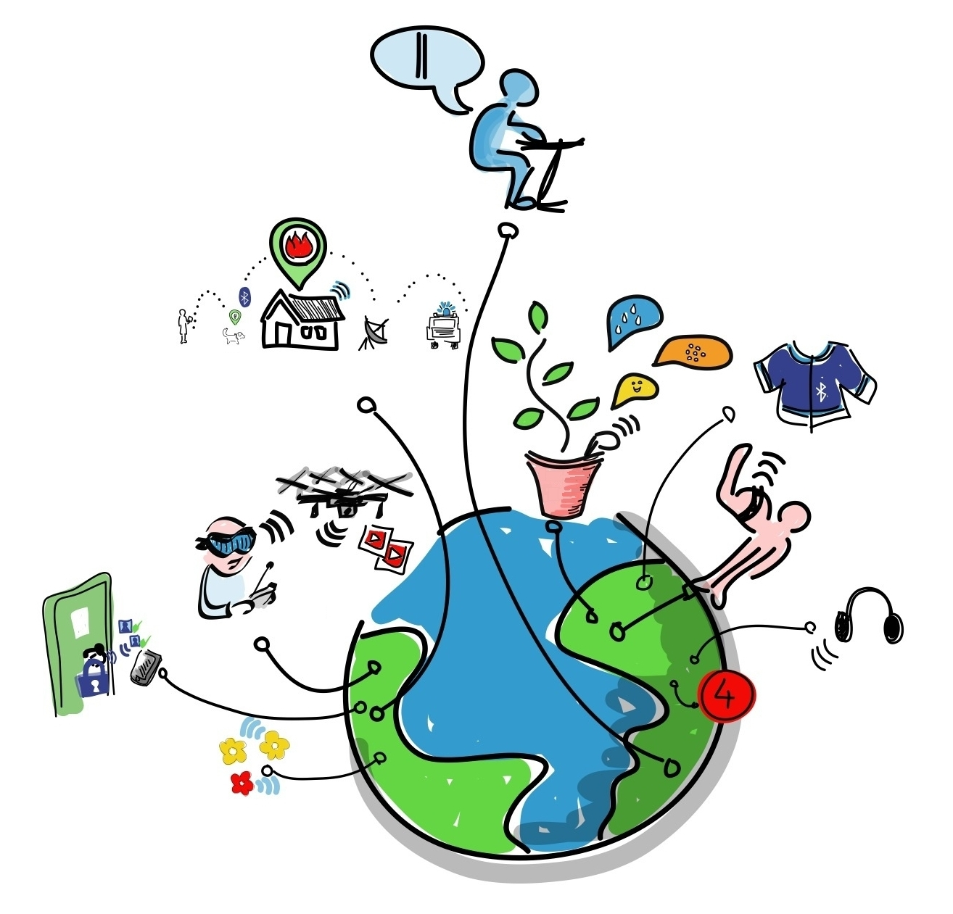
What is the history of IoT
According to Cisco Internet Business Solutions Group (IBSG), the Internet of Things was born in between 2008 and 2009 at simply the point in time when more “things or objects” were connected to the Internet than people.
Citing the growth of smartphones, tablet PCs, etc the number of devices connected to the Internet was brought to 12.5 billion in 2010 (Related: see Kevin Kelly's One Machine), while the world’s human population increased to 6.8 billion, making the number of connected devices per person more than 1 (1.84 to be exact) for the first time in history.

Slide 3
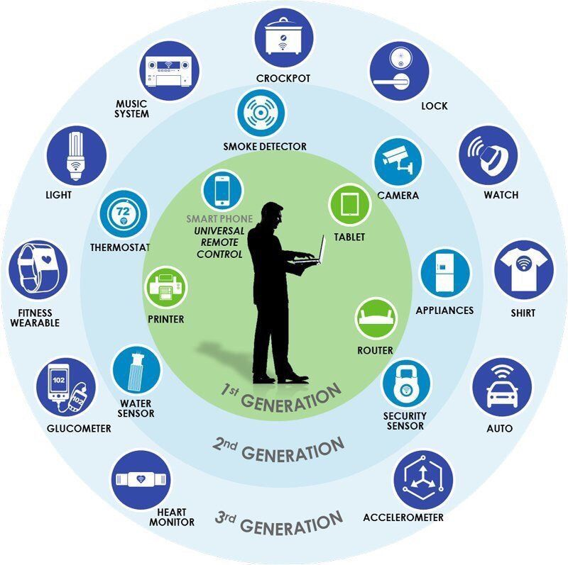
What technologies enable of IoT
3 IoT Enabling Technologies
3.1 Sensor and Actuator. ...
3.2 Machine-to-Machine (M2M) Communication. ...
3.3 Radio-Frequency Identification (RFID) ...
3.4 Near-Field Communication (NFC) ...
3.5 Wireless Sensor Network. ...
3.6 6LoWPAN.

Slide 4
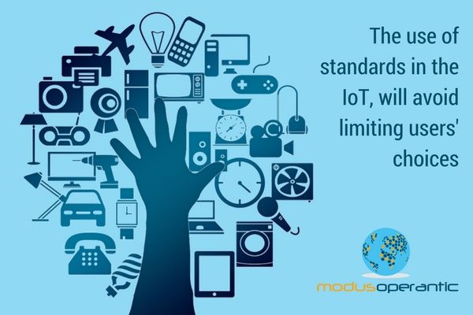
What is impact
The positive impact of the IoT on citizens, businesses and governments will be significant, ranging from helping governments reduce healthcare costs and improving quality of life, to reducing carbon footprints, increasing access to education in remote underserved communities, and improving transportation safety

Slide 5
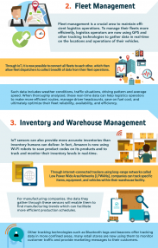
What is its impact going to be in the fure
As technology evolves, cities will start adopting smart technologies naturally. Cities around the world are investing in “start city” initiatives to improve citizen services, traffic control, utility consumption and quality of life. Cities will start automating, collecting, and managing data remotely as taxis, bike rental stations and even surveillance systems will be interconnected. This will make it easier to track a person, but it will also offer more convenience and value for the user at the same time. We might even be able to eliminate gridlocks since cars will be interconnected and keep the right distance between one another

Slide 6
references
Internet of things: From Wikipedia, the free encyclopedia
History of IoT Google .com
Technologies enable IoT:Google .com
Impact of IoT :Google.com
Impact going to be in the future :Google.com

